Slide 1
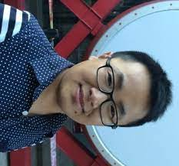
ACL-2022 Tutorial: Part A: Simple Uses of Deep Nets
Ken
Valia
Gary
Ernie
Yanjun
Zeyu
Ken Church, Baidu, USA
Valia Kordoni, Humboldt-Universitaet zu Berlin, Germany
Gary Marcus, Robust.AI
Ernest Davis, NYU
Yanjun MA, Baidu, China
Zeyu Chen, Baidu, China

Slide 2
Outline
Make deep nets accessible to masses (including non-programmers)
Part A: Glass is half-full
Deep nets can do much
Part B: Glass is half-empty
There is always more work to do
Advocate combo of Part A with
AI Knowledge Representation
Linguistics and Philosophy
GFT Code,
100s of examples,
slides, videos, papers

Slide 3
Agenda: Part A
Strategy
gft Cheatsheet
4-5 Functions + 4 Arguments
Amazing how much can be done with so little
Seven Simple Examples
More Tasks: MT, ASR, Vision
Two Questions
How do we find the good stuff?
How do we use the good stuff?
Why de-emphasize pre-training?
Conclusions

Slide 4
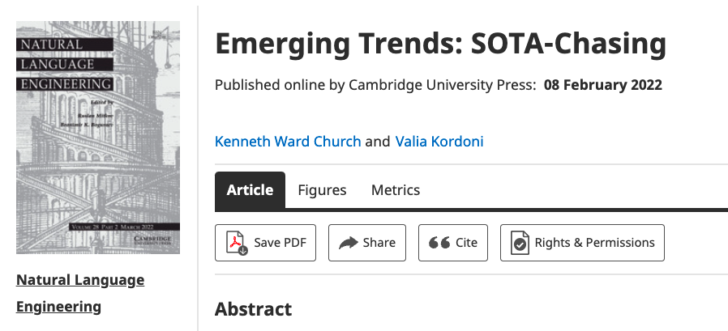
Strategy: Inclusiveness
Get your priorities right: Inclusiveness >> Exclusiveness
SOTA-Chasing 👎 (Exclusive: mine is bigger than yours)
Crossing the Chasm 👍 (Inclusive: Appeal to mainstream users)
Hubs: Get big quick 👍 (Inclusive: Usage >> SOTA)

Slide 5
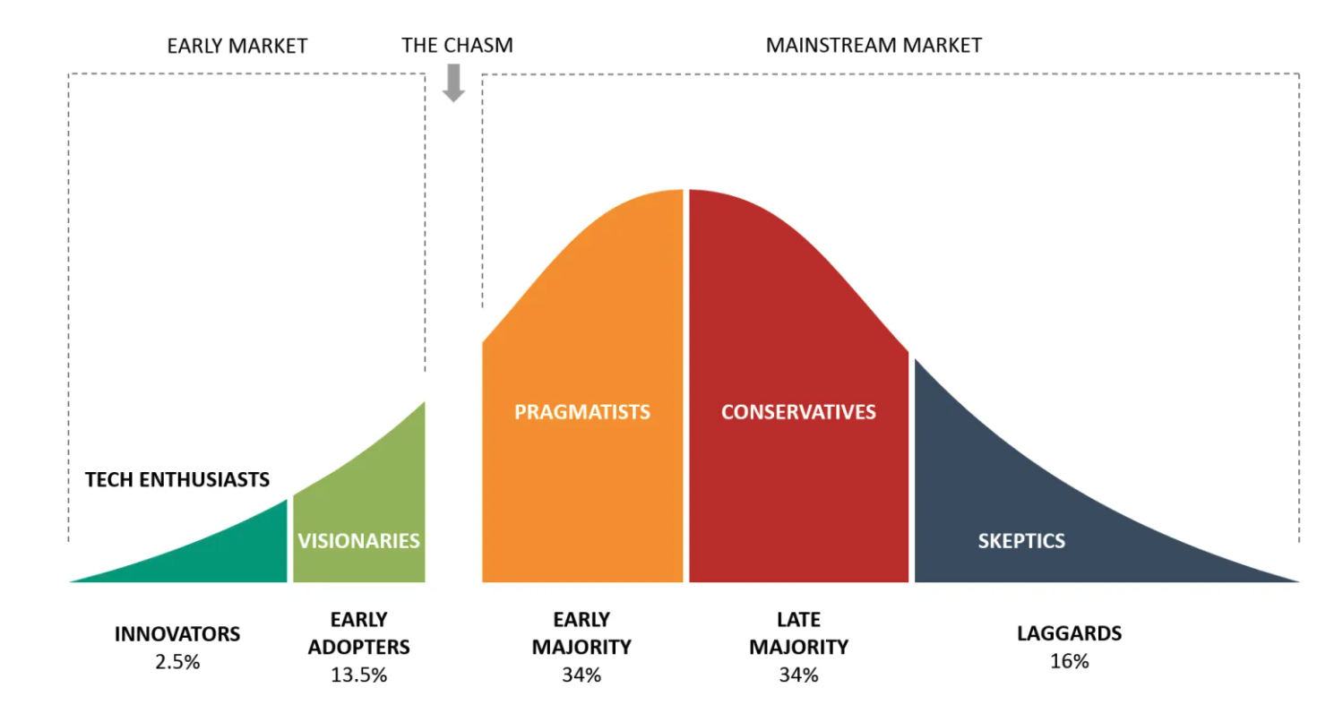
Bigger Opportunities:
(l)users (aka poets)
Engineers

Slide 6
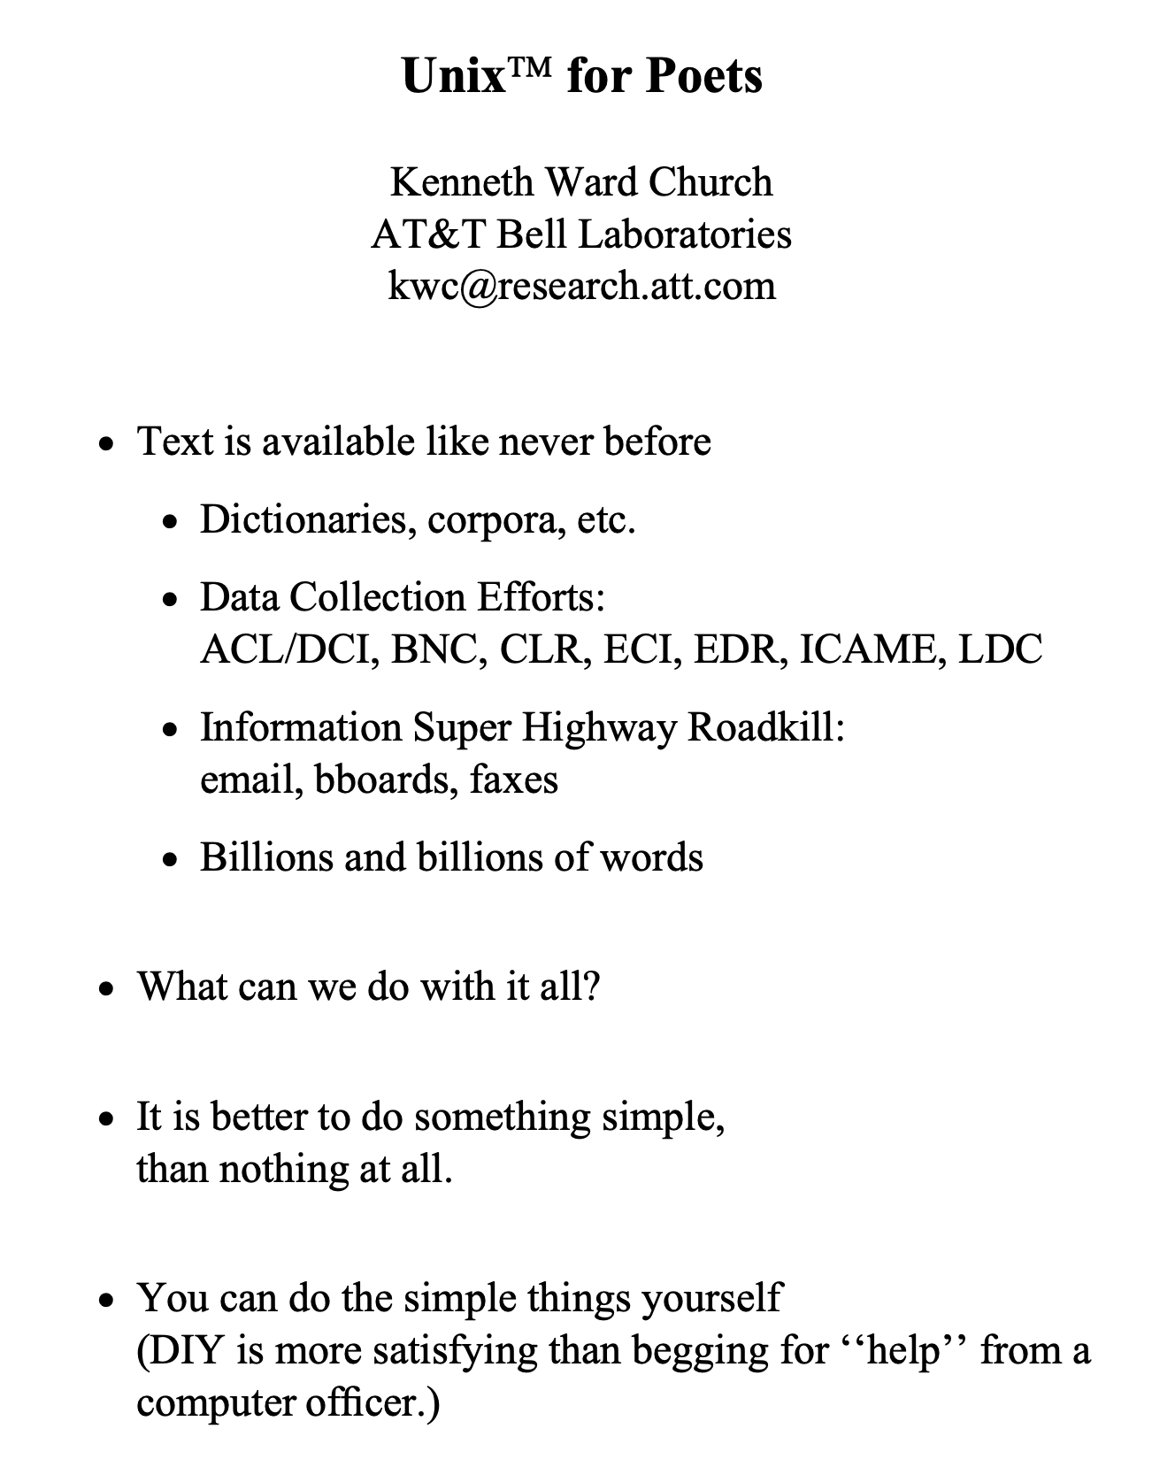
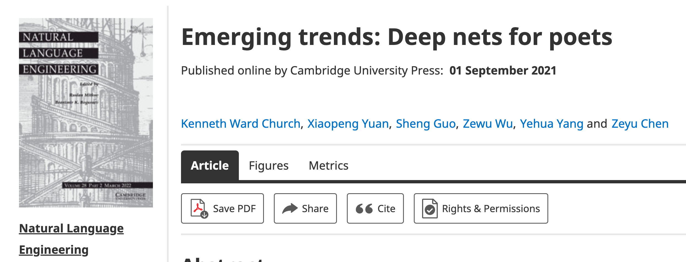
Poets
Poets is an imperfect metaphor,
intended as a gesture toward inclusion.
The future for deep nets
will benefit by reaching out to
a broad audience of potential users,
including people with
little or no programming skills,
and little interest in training models.
Lessons from success of Unix
Less is more
Inclusion: Appeal to power users as well as masses
Portability: Inclusiveness++

Slide 7
Hub Strategy: Usage >> SOTA
(Sensible) Priority for Startups
(Mistaken) Priority Research
Startup Strategy:
Get big quick
SOTA is like sprinting (hard work)
Avoid temptation to sprint to front
(except when it is worth the effort)
Hubs spend most of the race
in the peloton drafting researchers
Make it easy for 3rd parties
to post their best models on your hub
Use of 3rd parties → Wide range in quality
Best are amazing: best in class, industrial strength…
But some don’t work well, and may not even load…
Help users find good stuff

Slide 8
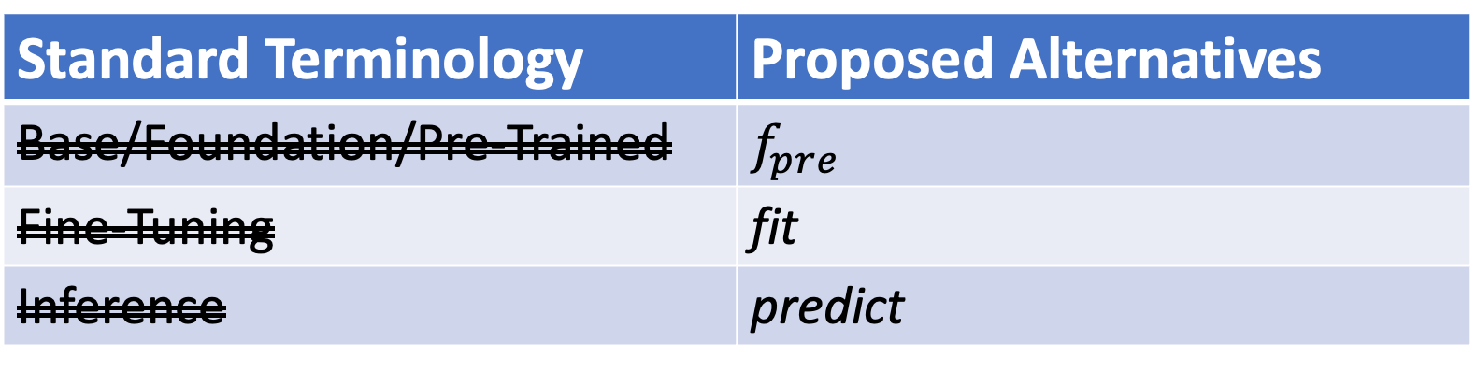
Terminology
0-shot
Standard Terminology | Proposed Alternatives
Base/Foundation/Pre-Trained | $$f_{pre}$$
Fine-Tuning | fit
Inference | predict
Unsupervised
Supervised
Emphasize this
Emphasize this
Few-shot
De-emphasize this
Teaser: Stay-tuned

Slide 9
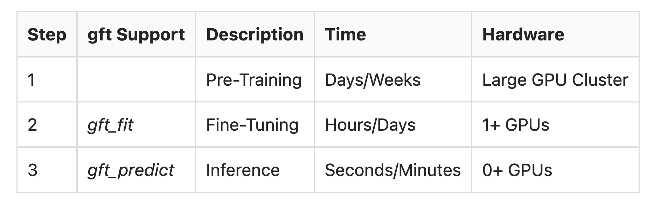
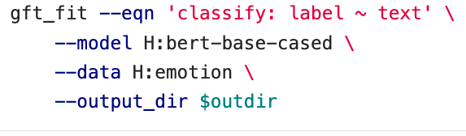
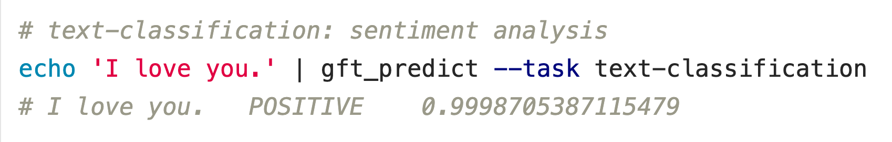

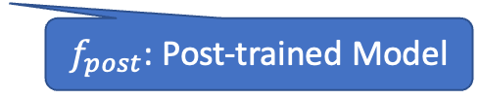
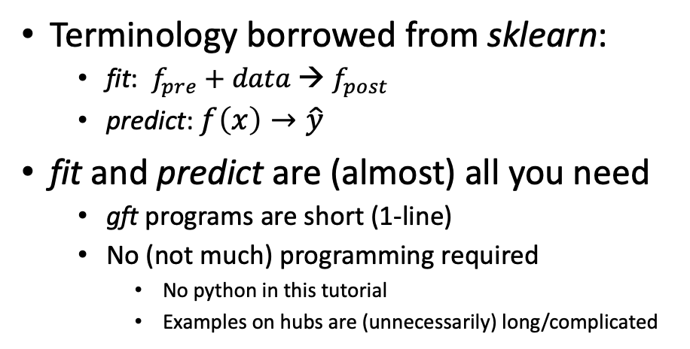
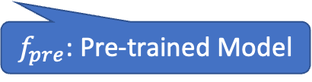

gft (general fine-tuning): A Little Language for Deep Nets (Unix Philosophy: Less is More)
Standard 3-Step Recipe
Examples of 1-line GFT Programs
Step 2: gft_fit
Data
$f_{pre}$: Pre-trained Model
Terminology borrowed from sklearn:
fit: $f_{pre}$ $+ data$→ $f_{post}$
predict: $f\left(x\right)→\hat{y}$
fit and predict are (almost) all you need
gft programs are short (1-line)
No (not much) programming required
No python in this tutorial
Examples on hubs are (unnecessarily) long/complicated
$f_{post}$: Post-trained Model
Step 3: gft_predict
$$x$$
$$\hat{y}$$
Score

Slide 10
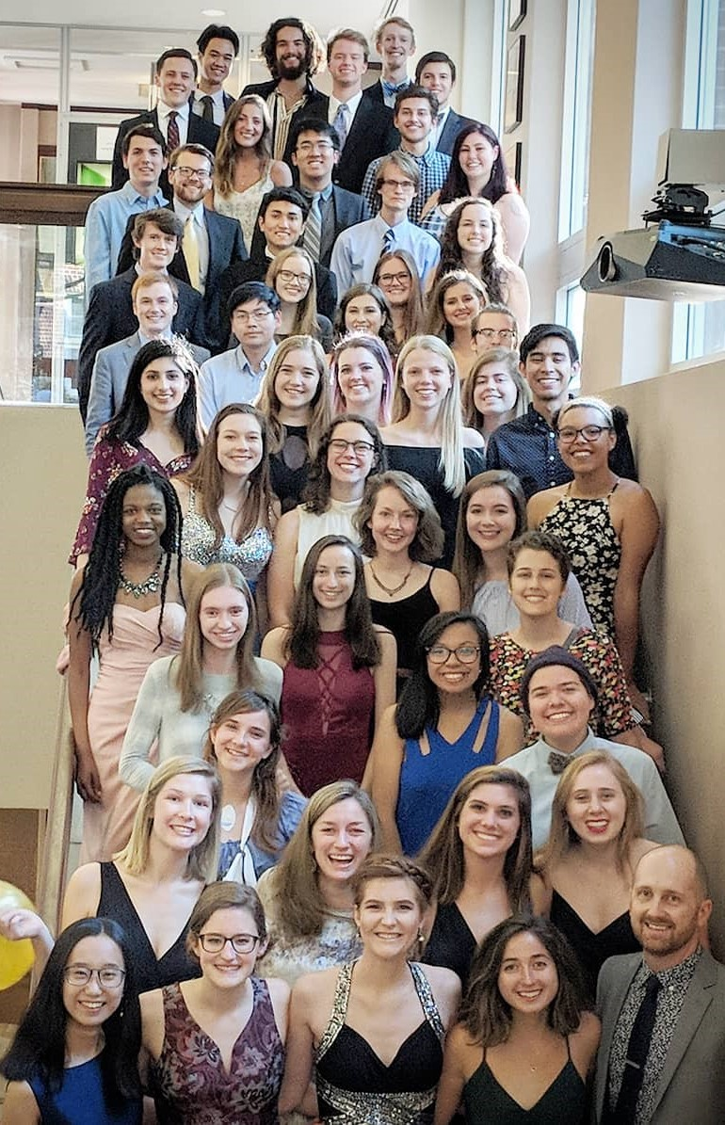
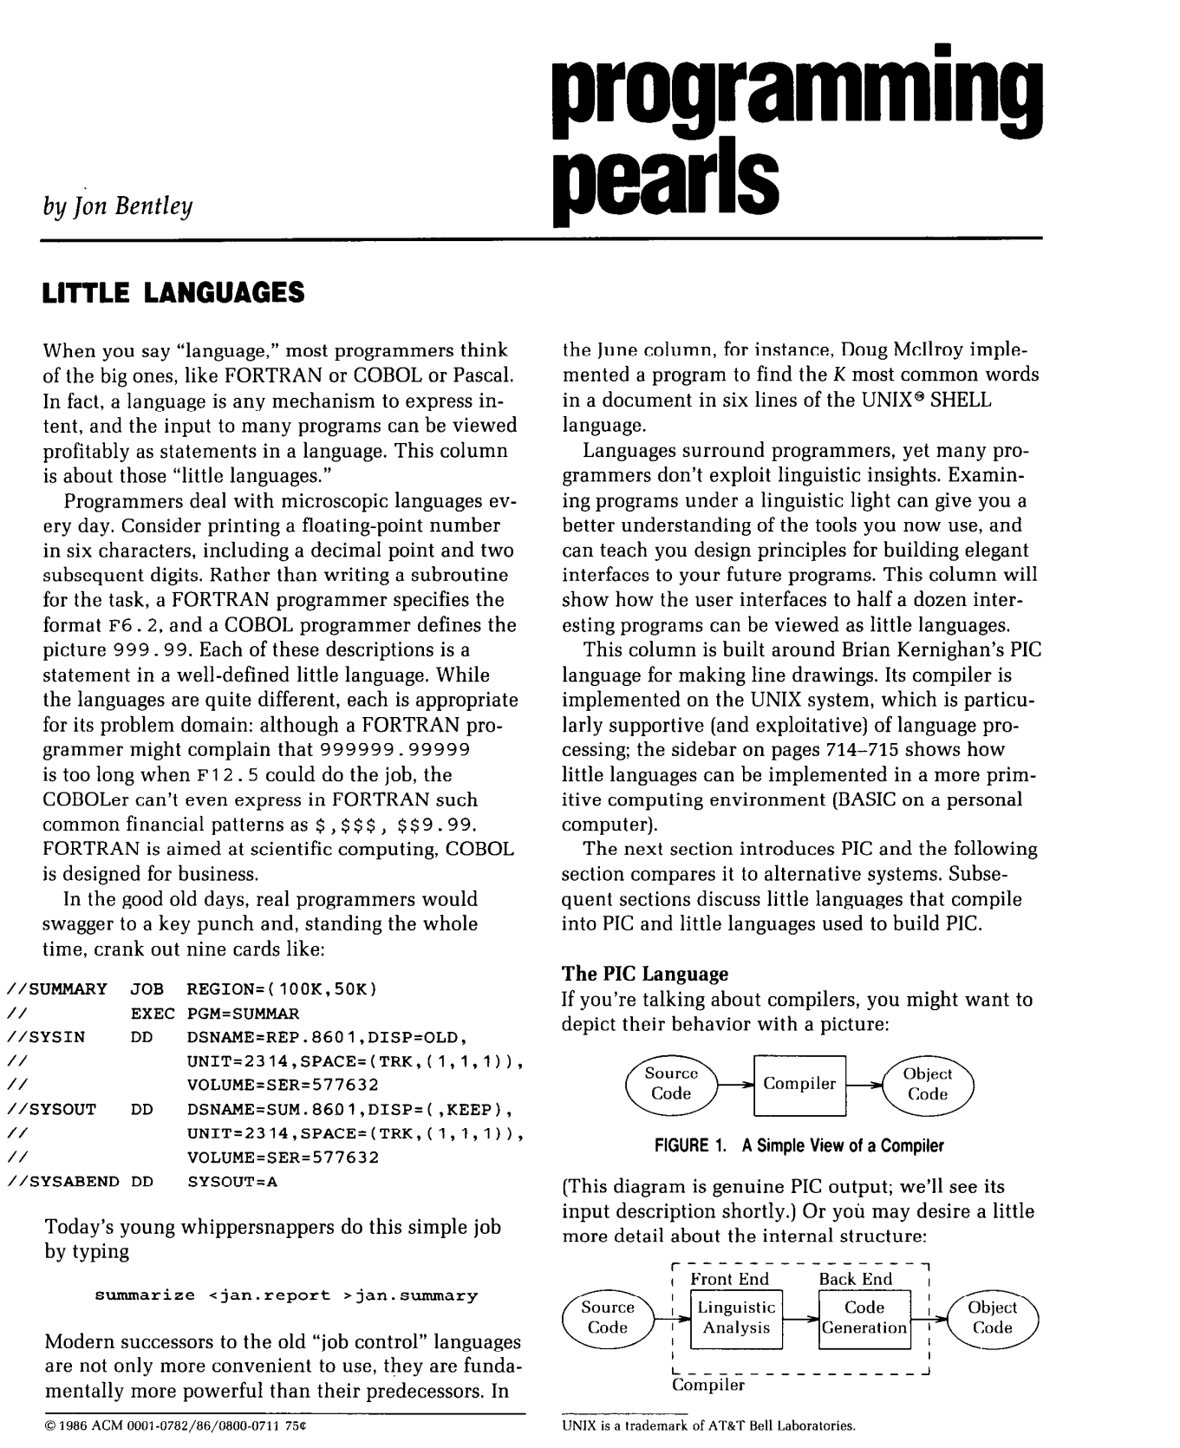
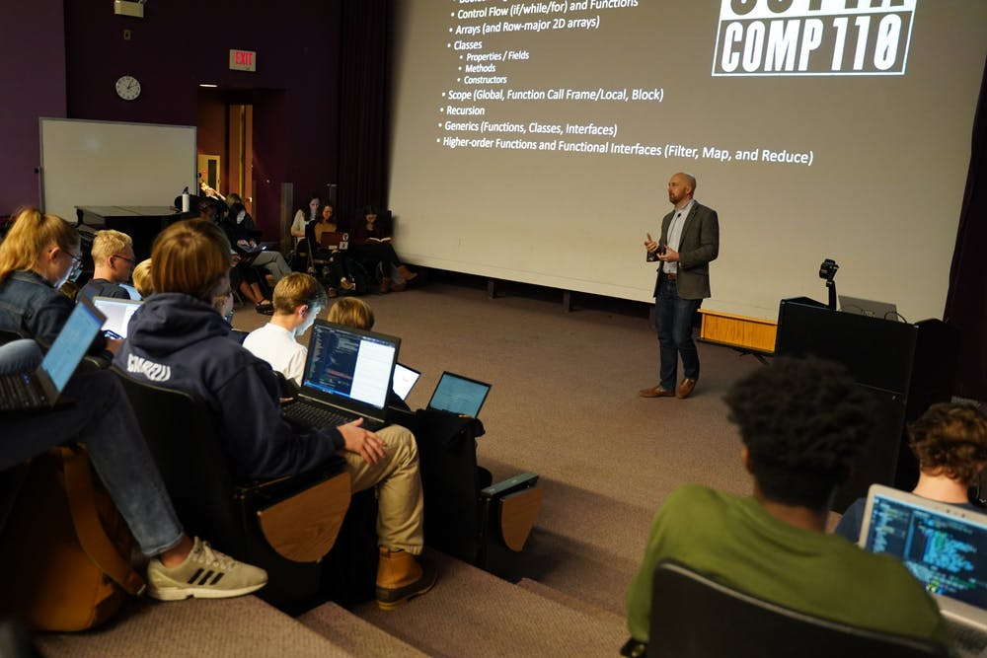
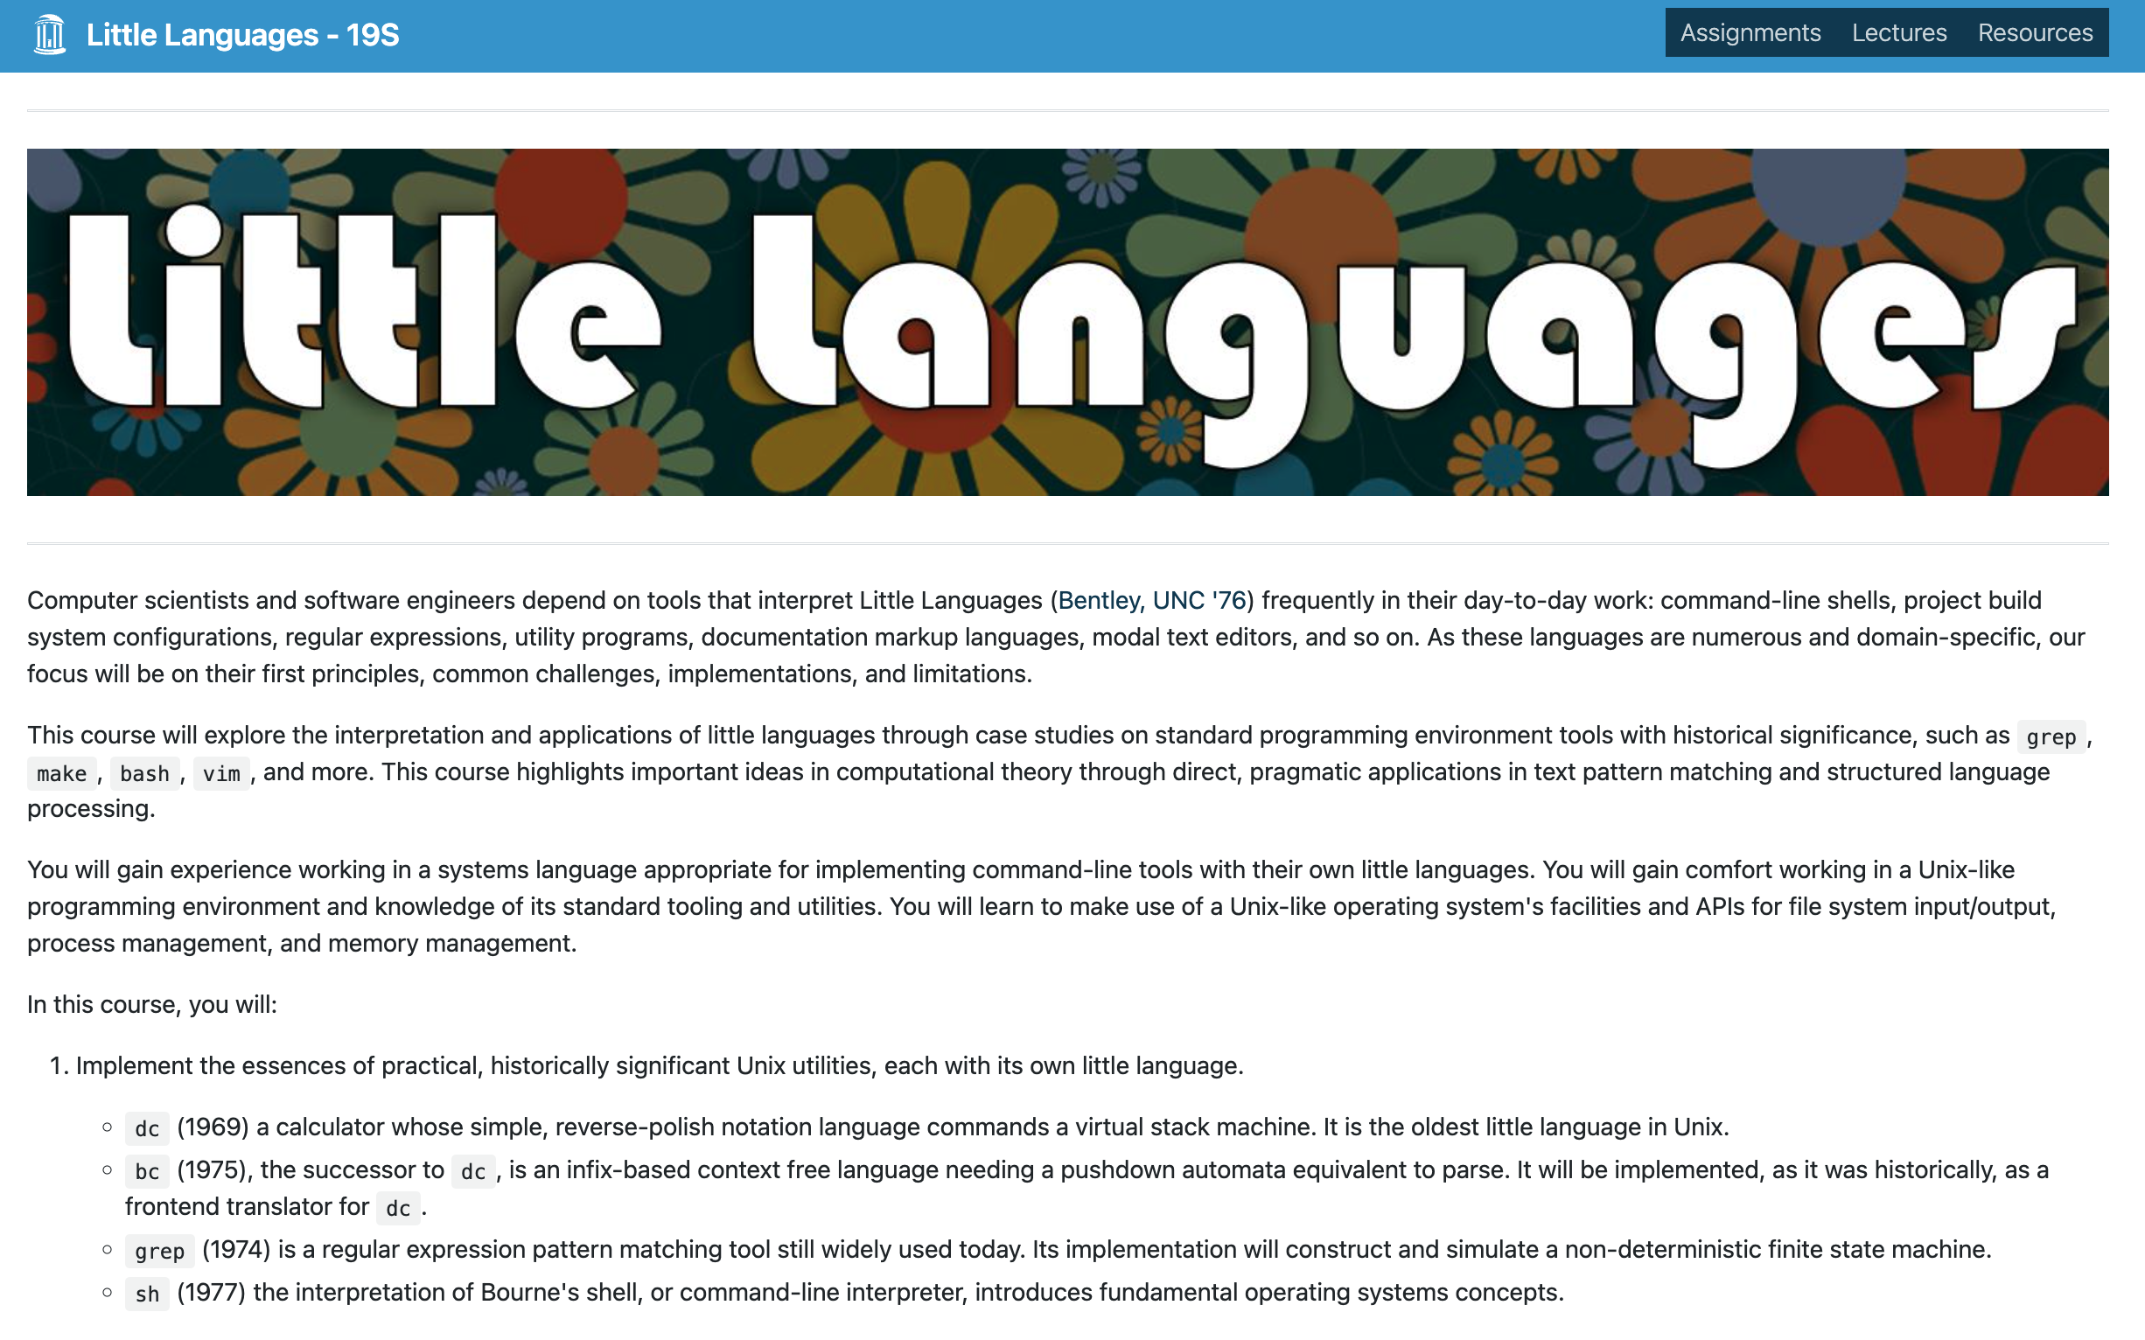
Little Languages (from Unix)
Bentley (CACM-1986)
https://comp590-19s.github.io/
Kris Jordan (UNC Chapel Hill, 2019)

Slide 11
Little Languages (from Unix)
Bentley (CACM-1986)
https://comp590-19s.github.io/
Kris Jordan (UNC Chapel Hill, 2019)

Slide 12
We propose gft, a Little Language
In the good old days,
real programmers would copy a few hundred lines of PyTorch from HuggingFace
and modify as necessary to change
models,
datasets,
task,
etc.
With gft, 100s of lines → 1-line
More accessible to masses
(including non-programmers)

Slide 13
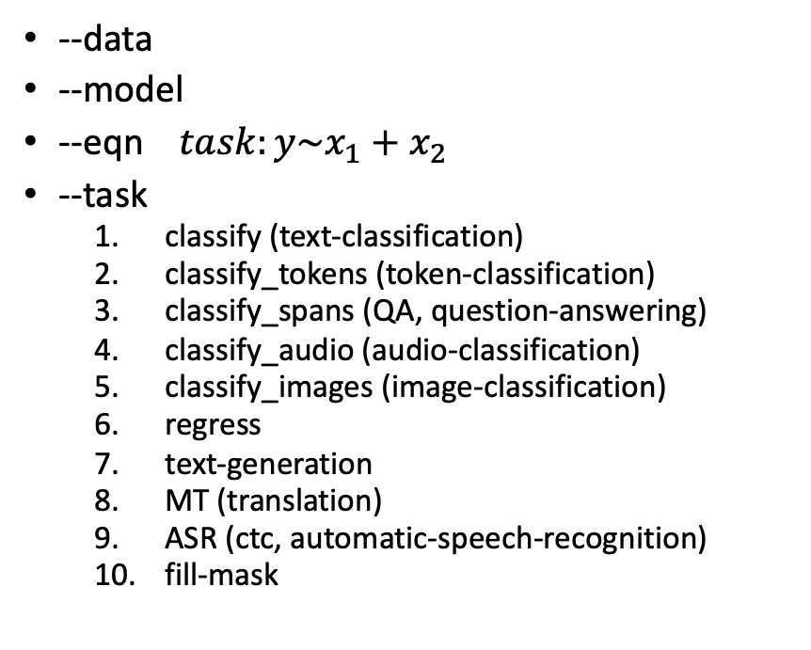
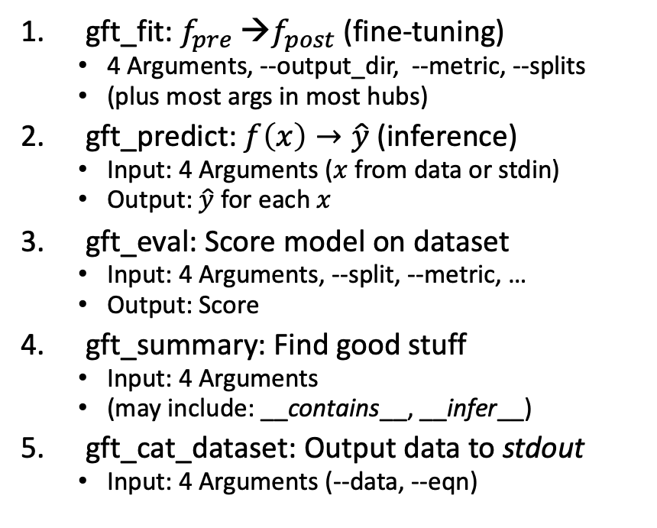
gft Cheat Sheet (General Fine-Tuning)
Amazing how much can be done with so little
4+1 Functions
4 Arguments
gft_fit: $f_{pre}$ →$f_{post}$(fine-tuning)
4 Arguments, --output_dir, --metric, --splits
(plus most args in most hubs)
gft_predict: $f\left(x\right)→\hat{y}$ (inference)
Input: 4 Arguments ($x$ from data or stdin)
Output: $\hat{y}$ for each $x$
gft_eval: Score model on dataset
Input: 4 Arguments, --split, --metric, …
Output: Score
gft_summary: Find good stuff
Input: 4 Arguments
(may include: __contains__, __infer__)
gft_cat_dataset: Output data to stdout
Input: 4 Arguments (--data, --eqn)
--data
--model
--eqn $task:y\sim x_{1}+x_{2}$
--task
classify (text-classification)
classify_tokens (token-classification)
classify_spans (QA, question-answering)
classify_audio (audio-classification)
classify_images (image-classification)
regress
text-generation
MT (translation)
ASR (ctc, automatic-speech-recognition)
fill-mask

Slide 14
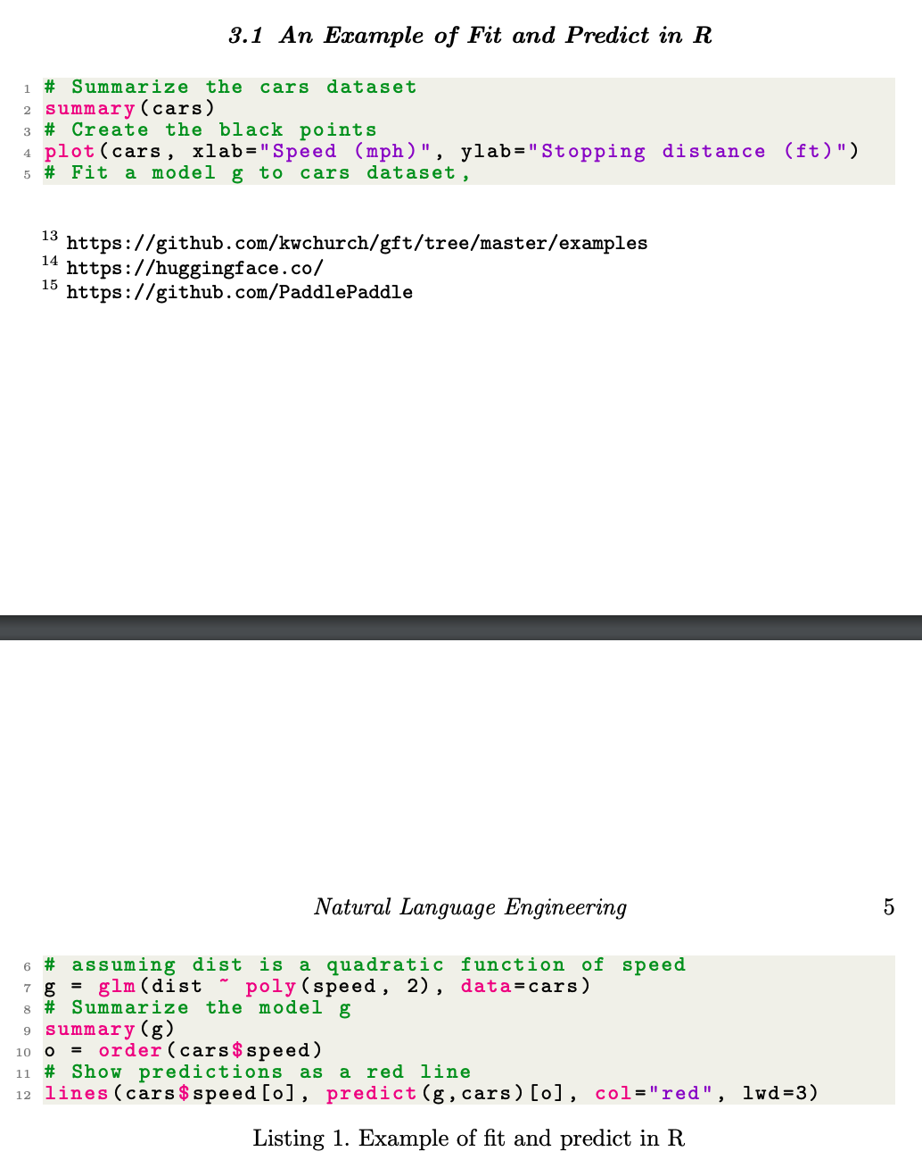
gft (General Fine-Tuning) is based on glm (General Linear Models) in R
Make deep nets look like regression
(Not much programming)

Slide 15
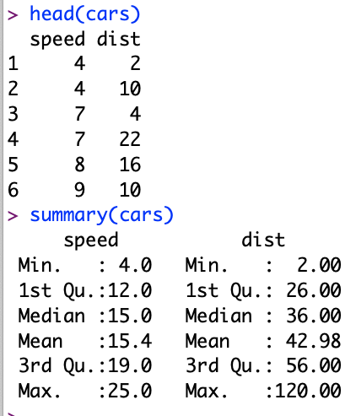
Regression in R: Summarize (almost) anything
Black Points:
cars dataset
Summarize a dataset (cars)
Red Line:
Model (g)

Slide 16
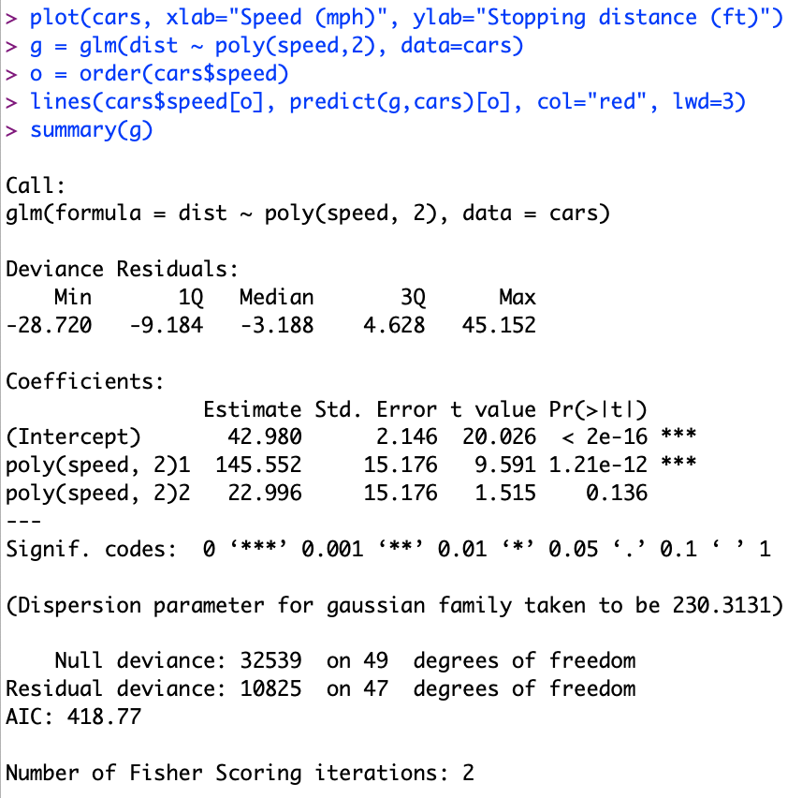
Regression in R: Summarize (almost) anything
Fit a model (g) to data (cars)

Slide 17
Regression in R: Summarize (almost) anything
Fit a model (g) to data (cars)
Predict
Summarize a model (g)
Opportunity to Improve g

Slide 18
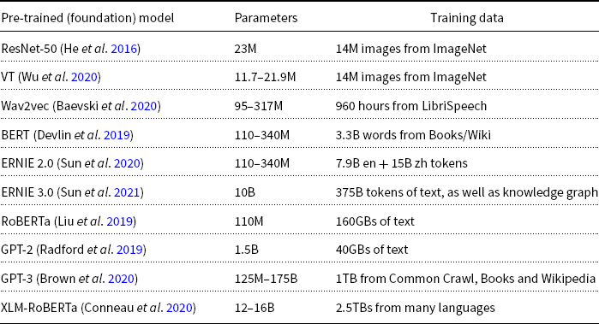
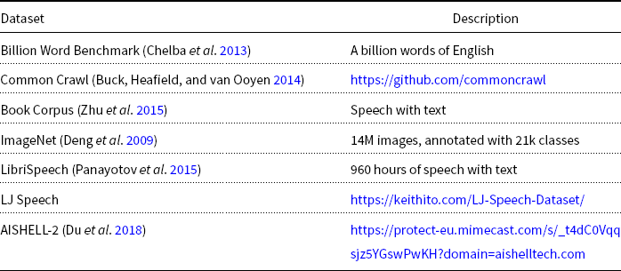
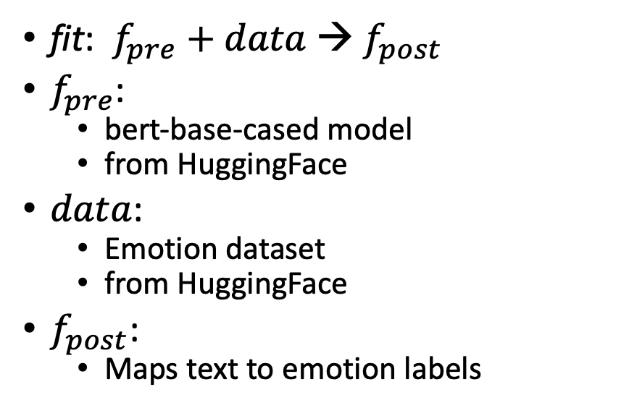
What is fine-tuning fit?
fit: $f_{pre}$ $+ data$→ $f_{post}$
$f_{pre}$:
bert-base-cased model
from HuggingFace
$data$:
Emotion dataset
from HuggingFace
$f_{post}$:
Maps text to emotion labels
R Program
gft Program

Slide 19
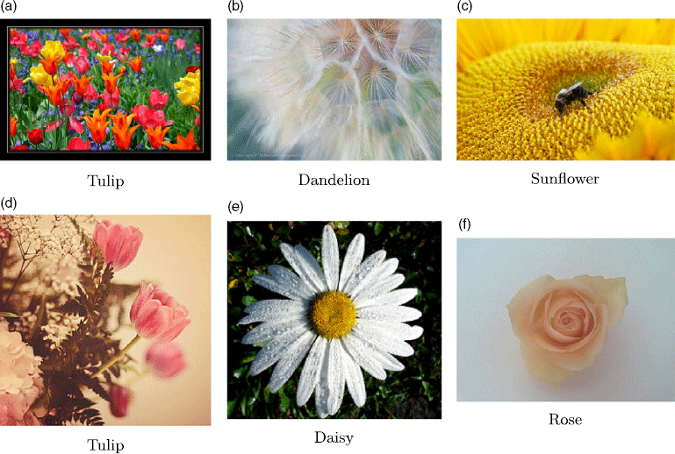
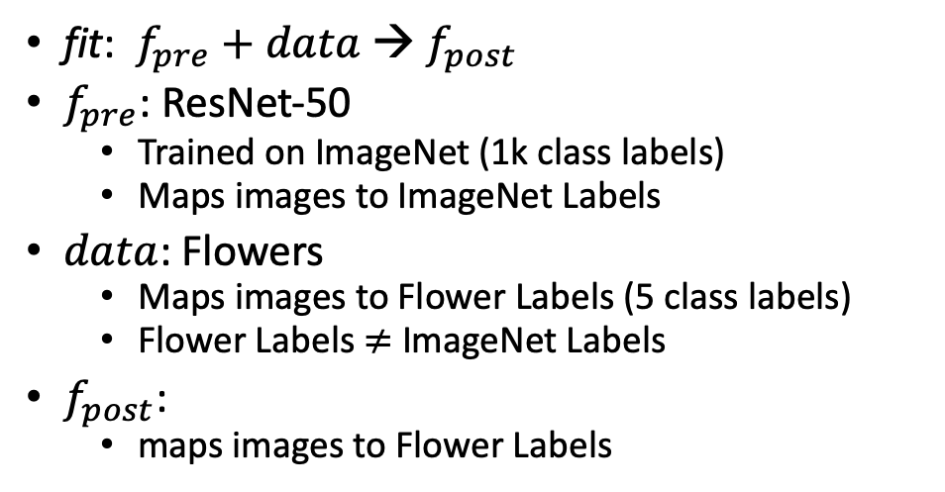

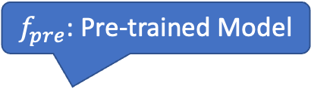
What is fine-tuning fit?
Flowers
$$data$$
fit: $f_{pre}$ $+ data$→ $f_{post}$
$f_{pre}$: ResNet-50
Trained on ImageNet (1k class labels)
Maps images to ImageNet Labels
$data$: Flowers
Maps images to Flower Labels (5 class labels)
Flower Labels $≠$ ImageNet Labels
$f_{post}$:
maps images to Flower Labels
$f_{pre}$: Pre-trained Model

Slide 20
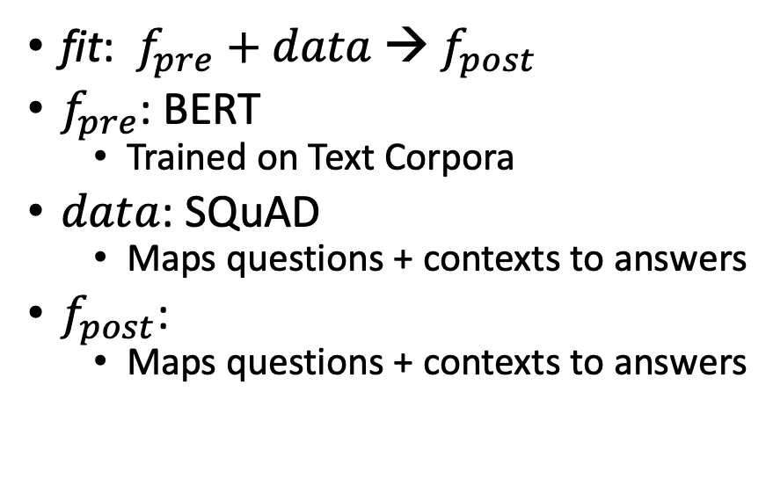
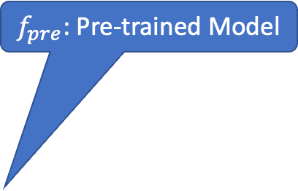
What is fine-tuning fit?
SQuAD
fit: $f_{pre}$ $+ data$→ $f_{post}$
$f_{pre}$: BERT
Trained on Text Corpora
$data$: SQuAD
Maps questions + contexts to answers
$f_{post}$:
Maps questions + contexts to answers
Question:
What does AFC stand for?
Context:
The American Football Conference (AFC) champion Denver Broncos defeated the National Football Conference (NFC) champion Carolina Panthers 24–10 to earn their third Super Bowl title.
Answer:
American Football Conference
Text with no markup
$f_{pre}$: Pre-trained Model

Slide 21
gft Design Goals
Inclusiveness:
Accessible to Masses
(including non-programmers)
Portability
Ease-of-Use/Transparency >> SOTA
Hide Complexity/Magic (Alchemy)
No one would suggest
Regression-like methods are ``intelligent’’

Slide 22
Portability: Inclusiveness + Hedge
gft Programs
H → HuggingFace
gft_fit --model H:bert-base-cased \
--data H:emotion \
--output_dir $1 \
--eqn 'classify: label ~ text'
Hedge
(Supply Chains)
Hedge
(Supply Chains)
P → PaddleNLP
gft_fit --model P:ernie-tiny \
--data P:chnsenticorp \
--output_dir $1 \
--eqn 'classify: label ~ text'
Emphasis on Chinese

Slide 23
Strategy Conclusions
Inclusiveness
Appeal to Power Users as well as Masses
Accessible to Masses
Portability
Transparency
Avoid Magic / Alchemy
Hide Complexity
Embrace Historical Precedents
Little Languages from Unix
Fit/Predict/Summary/glm Equations from R

Slide 24
Agenda: Part A
Strategy
gft Cheatsheet
4-5 Functions + 4 Arguments
Amazing how much can be done with so little
Seven Simple Examples
More Tasks: MT, ASR, Vision
Two Questions
How do we find the good stuff?
How do we use the good stuff?
Why de-emphasize pre-training?
Conclusions

Slide 25
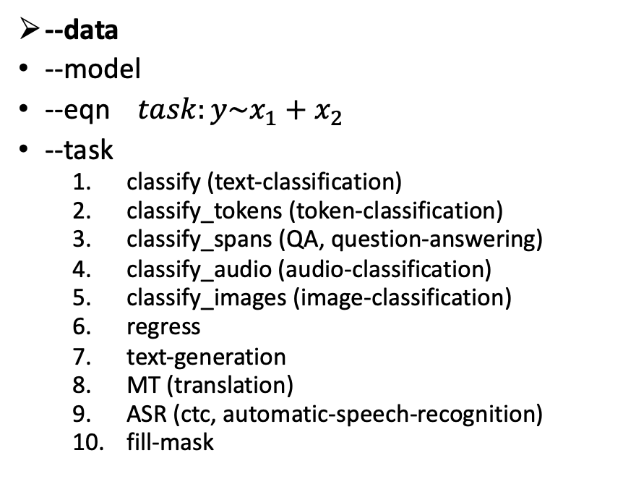
gft Cheat Sheet (General Fine-Tuning)
Next topic
4+1 Functions
4 Arguments
gft_fit: $f_{pre}$ →$f_{post}$(fine-tuning)
4 Arguments, --output_dir, --metric, --splits
(plus most args in most hubs)
gft_predict: $f\left(x\right)→\hat{y}$ (inference)
Input: 4 Arguments ($x$ from data or stdin)
Output: $\hat{y}$ for each $x$
gft_eval: Score model on dataset
Input: 4 Arguments, --split, --metric, …
Output: Score
gft_summary: Find good stuff
Input: 4 Arguments
(may include: __contains__, __infer__)
gft_cat_dataset: Output data to stdout
Input: 4 Arguments (--data, --eqn)
--data
--model
--eqn $task:y\sim x_{1}+x_{2}$
--task
classify (text-classification)
classify_tokens (token-classification)
classify_spans (QA, question-answering)
classify_audio (audio-classification)
classify_images (image-classification)
regress
text-generation
MT (translation)
ASR (ctc, automatic-speech-recognition)
fill-mask

Slide 26
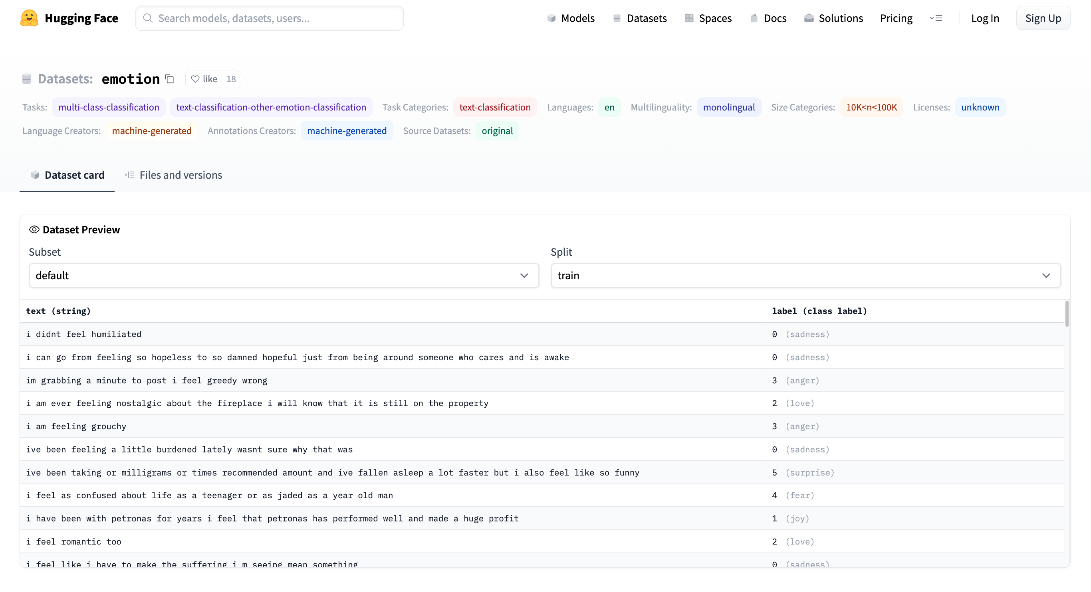
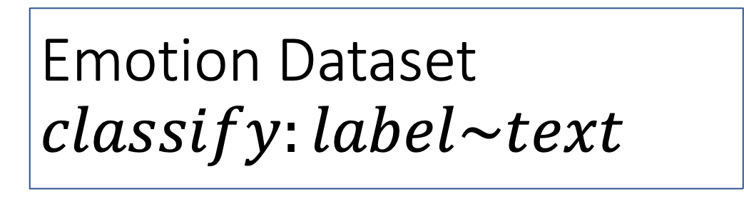
Emotion Dataset $$classify:label\sim text$$
Task
Columns
Columns
Row

Slide 27
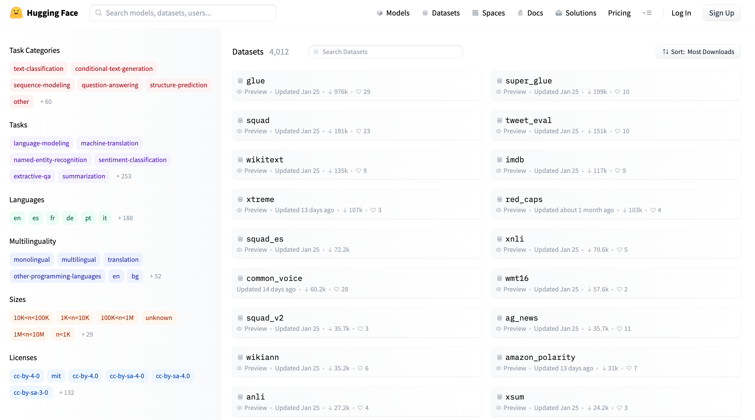
More Terminology
Dataset (4k)
Models (40k)
Tasks
classify
regress
translation
ASR
…
https://huggingface.co/datasets

Slide 28

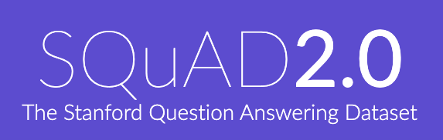
Two Popular Datasets
https://gluebenchmark.com/
https://rajpurkar.github.io/SQuAD-explorer/

Slide 29
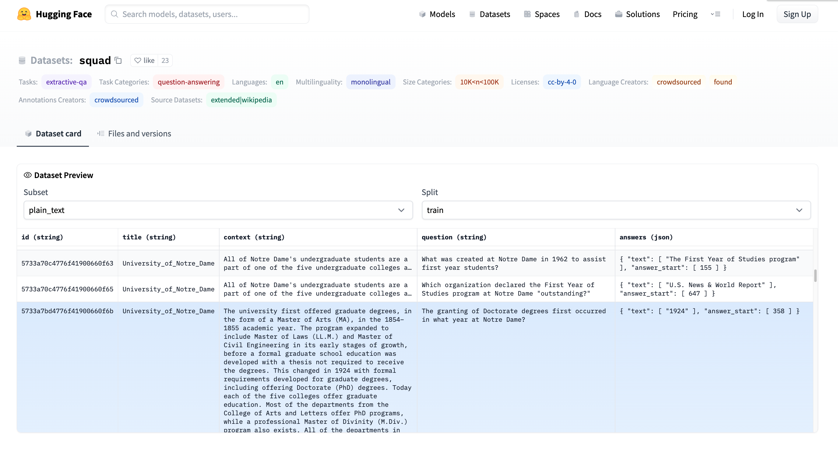
More Terminology
Dataset (4k)
Splits: train, validation, test
Columns:
id, title, context, question, answers
Rows
Models (36k)
Tasks:
classification, regression, etc.
https://huggingface.co/datasets/squad/viewer/plain_text/train

Slide 30
More Terminology
Answer starts at context[358:]
Dataset (4k)
Splits: train, validation, test
Columns:
title, context, question, answers
Rows
Answer is a span
(substring of context)
Task: Question-Answering (QA)
Classify Spans:
Answer is a substring of context

Slide 31
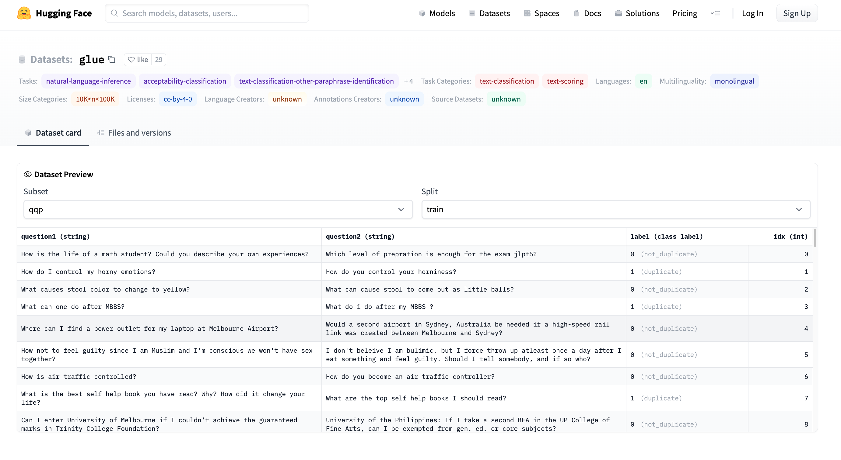
GLUE https://huggingface.co/datasets/glue/viewer/qqp/train

Slide 32
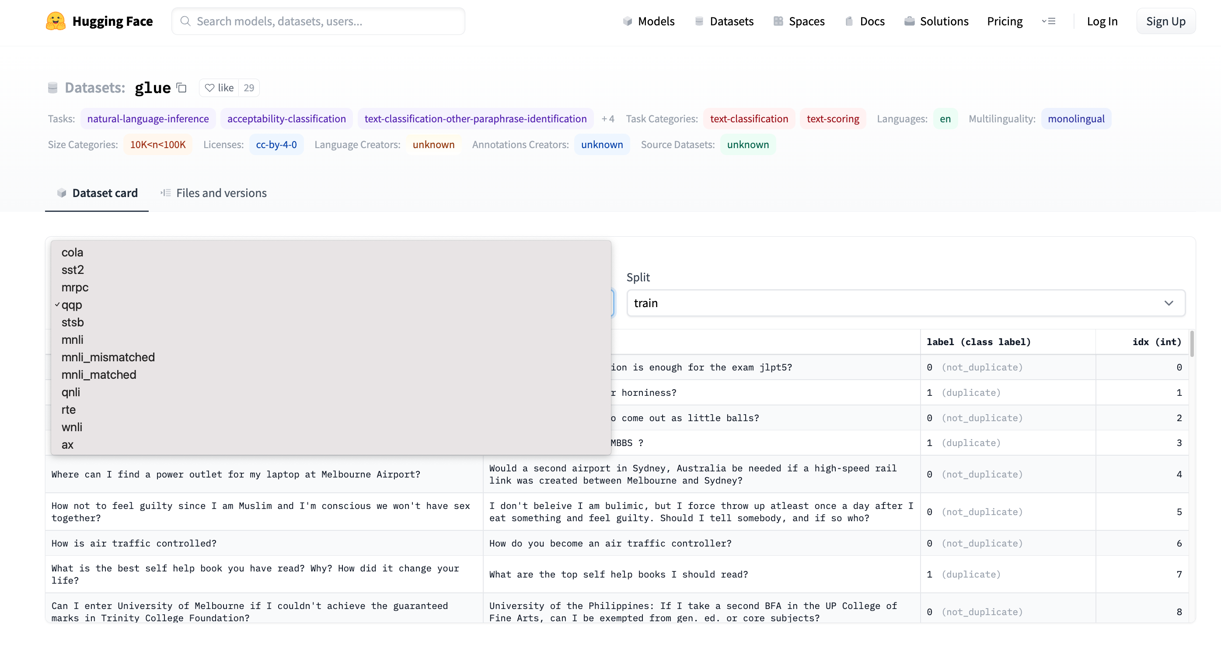
GLUE https://huggingface.co/datasets/glue/viewer/qqp/train
Terminology: Subset

Slide 33
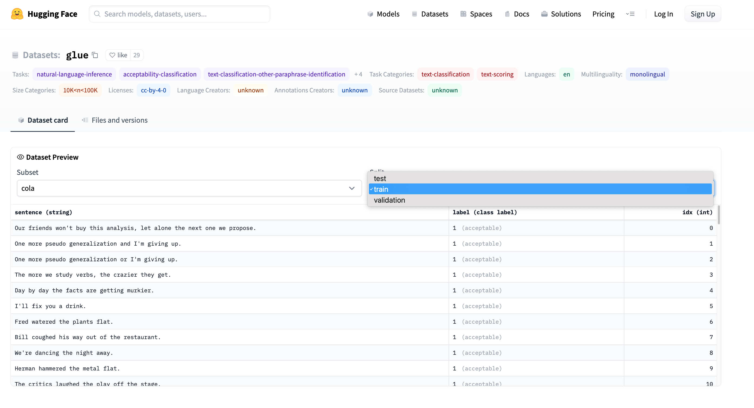
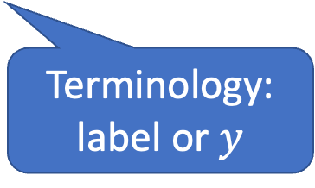
GLUE https://huggingface.co/datasets/glue/viewer/qqp/train
Terminology: Splits
Terminology:
label or $y$

Slide 34

Two Perspectives on Datasets
Machine Learning
Psychology (Presupposes $∃$Hypothesis)
Splits: train/val/test
Treat rows as iid
Identical and independently distributed
Idealistic, but maybe unrealistic
Changes over time, Context, etc.
More papers on models
than Datasets
Relatively little interest in
Is the Dataset Realistic?
Motivation? (Does anyone care? If so, who?)
What is the dataset testing?
Sampling/balance? From which population?
Can it be gamed? Leakage?
Validity
Content validity
Construct validity
Criterion validity
Face validity
Discriminant validity
Reliability
Inter-rater reliability
Test-retest reliability
Internal reliability/Inter-item consistency
Split half reliability
Lexicography

Slide 35
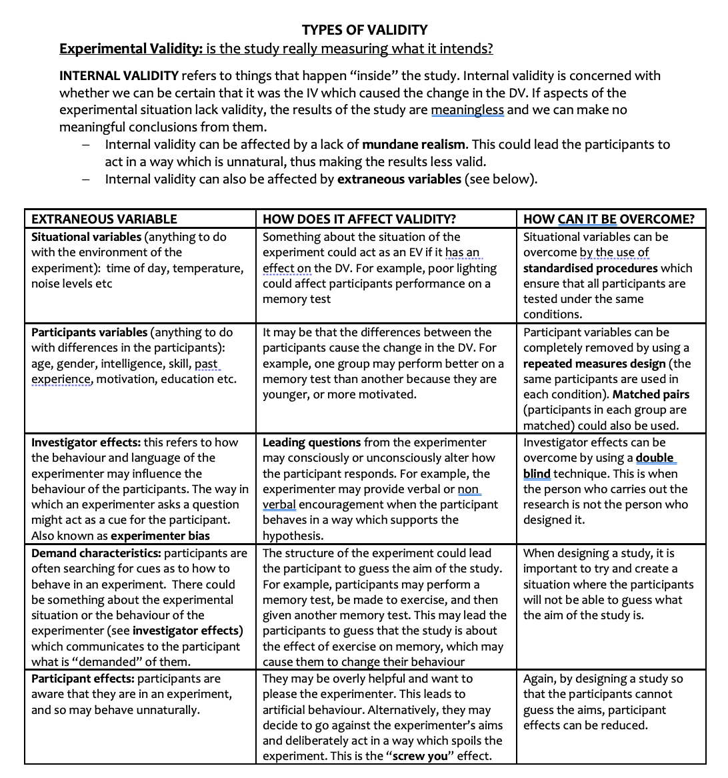
Discussion of Validity Assumes: Intention

Slide 36
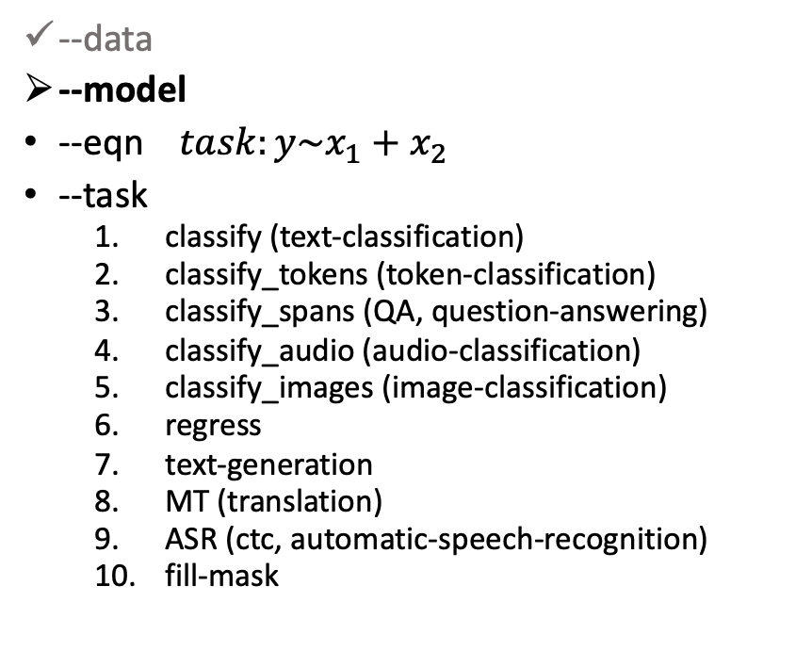
gft Cheat Sheet (General Fine-Tuning)
Next topic
4+1 Functions
4 Arguments
gft_fit: $f_{pre}$ →$f_{post}$(fine-tuning)
4 Arguments, --output_dir, --metric, --splits
(plus most args in most hubs)
gft_predict: $f\left(x\right)→\hat{y}$ (inference)
Input: 4 Arguments ($x$ from data or stdin)
Output: $\hat{y}$ for each $x$
gft_eval: Score model on dataset
Input: 4 Arguments, --split, --metric, …
Output: Score
gft_summary: Find good stuff
Input: 4 Arguments
(may include: __contains__, __infer__)
gft_cat_dataset: Output data to stdout
Input: 4 Arguments (--data, --eqn)
--data
--model
--eqn $task:y\sim x_{1}+x_{2}$
--task
classify (text-classification)
classify_tokens (token-classification)
classify_spans (QA, question-answering)
classify_audio (audio-classification)
classify_images (image-classification)
regress
text-generation
MT (translation)
ASR (ctc, automatic-speech-recognition)
fill-mask

Slide 37
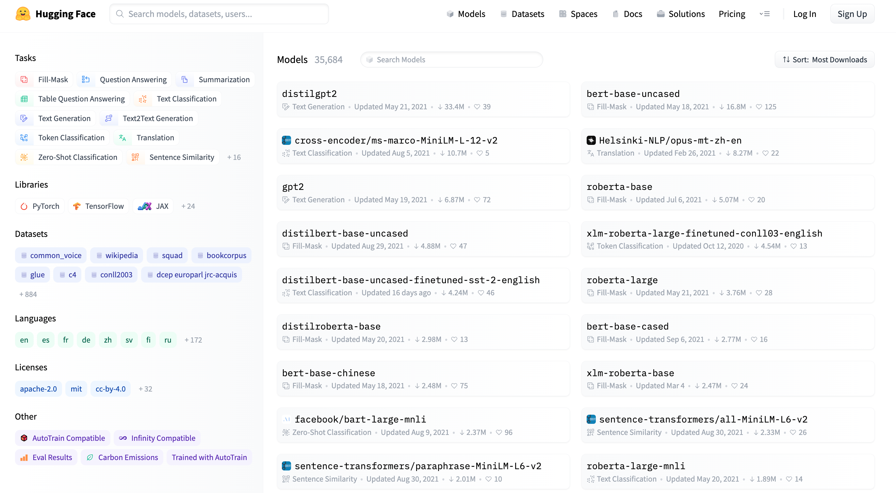
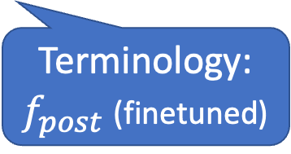
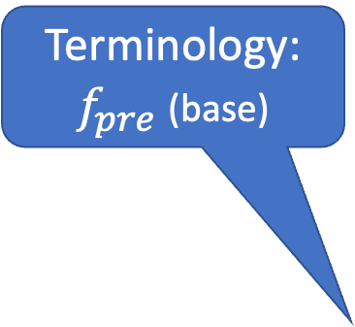

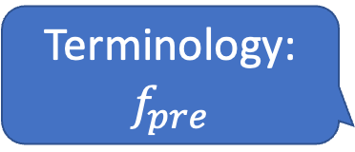

Models https://huggingface.co/models
Terminology:
$$f,f_{pre},f_{post}$$
Task:
Fill Mask
Terminology:
$f_{pre}$ (base)
Terminology:
$$f_{pre}$$
Task:
Translation
Terminology:
$f_{post}$ (finetuned)
Terminology:
$$f_{pre}$$
Task:
Token classification

Slide 38

gft Cheat Sheet (General Fine-Tuning)
4+1 Functions
4 Arguments
gft_fit: $f_{pre}$ →$f_{post}$(fine-tuning)
4 Arguments, --output_dir, --metric, --splits
(plus most args in most hubs)
gft_predict: $f\left(x\right)→\hat{y}$ (inference)
Input: 4 Arguments ($x$ from data or stdin)
Output: $\hat{y}$ for each $x$
gft_eval: Score model on dataset
Input: 4 Arguments, --split, --metric, …
Output: Score
gft_summary: Find good stuff
Input: 4 Arguments
(may include: __contains__, __infer__)
gft_cat_dataset: Output data to stdout
Input: 4 Arguments (--data, --eqn)
--data
--model
--eqn $task:y\sim x_{1}+x_{2}$
--task
classify (text-classification)
classify_tokens (token-classification)
classify_spans (QA, question-answering)
classify_audio (audio-classification)
classify_images (image-classification)
regress
text-generation
MT (translation)
ASR (ctc, automatic-speech-recognition)
fill-mask
Next topic

Slide 39
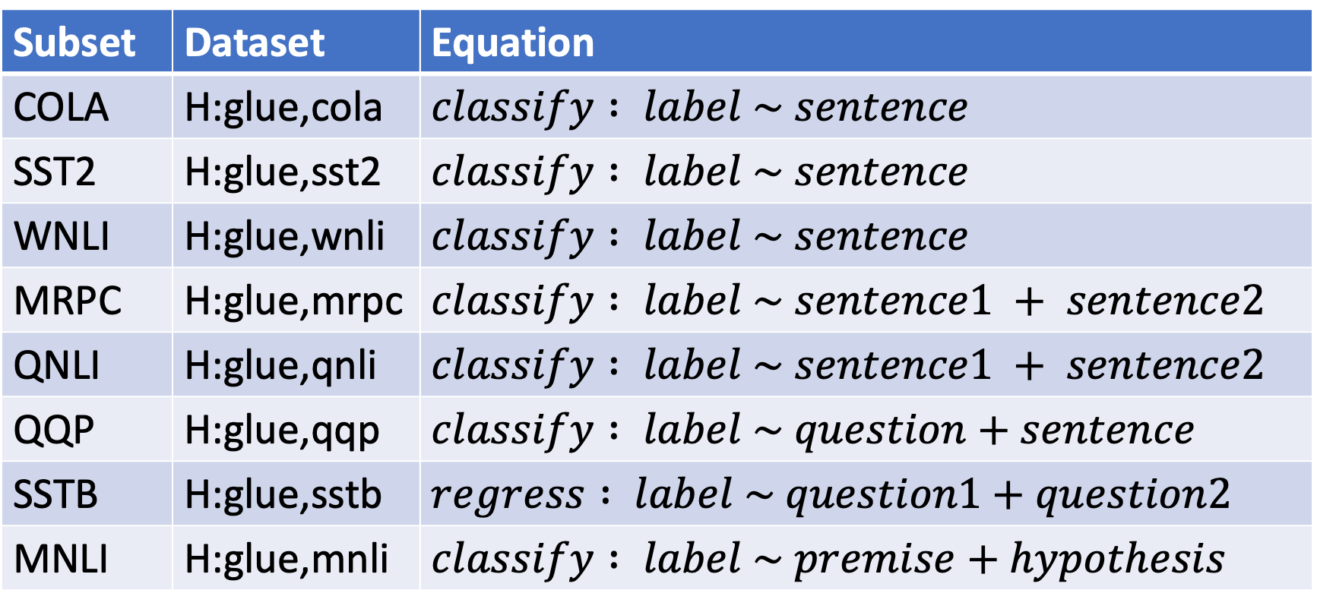
Simple Equations Cover Many Cases of Interest GLUE: A Popular Benchmark
Subset | Dataset | Equation
COLA | H:glue,cola | $$classify : label \sim sentence$$
SST2 | H:glue,sst2 | $$classify : label \sim sentence$$
WNLI | H:glue,wnli | $$classify : label \sim sentence$$
MRPC | H:glue,mrpc | $$classify : label \sim sentence1 + sentence2$$
QNLI | H:glue,qnli | $$classify : label \sim sentence1 + sentence2$$
QQP | H:glue,qqp | $$classify : label \sim question+sentence$$
SSTB | H:glue,sstb | $$regress : label \sim question1+question2$$
MNLI | H:glue,mnli | $$classify : label \sim premise+hypothesis$$

Slide 40
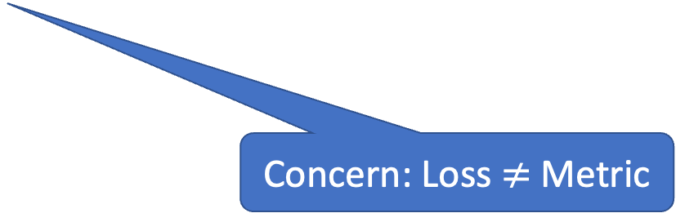
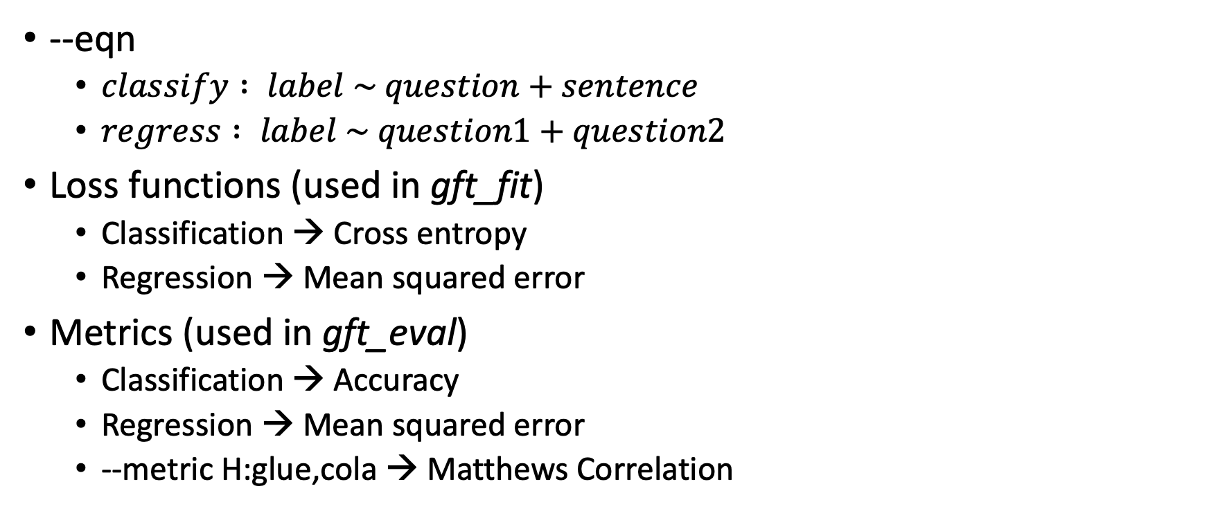
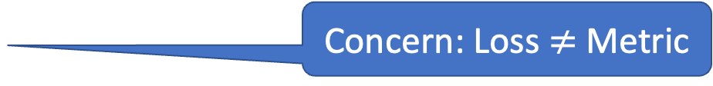
Loss Functions and Metrics (Defaults depend on task)
--eqn
$classify : label \sim question+sentence$
$regress : label \sim question1+question2$
Loss functions (used in gft_fit)
Classification → Cross entropy
Regression → Mean squared error
Metrics (used in gft_eval)
Classification → Accuracy
Regression → Mean squared error
--metric H:glue,cola → Matthews Correlation
Concern: Loss $≠$ Metric
Concern: Loss $≠$ Metric

Slide 41
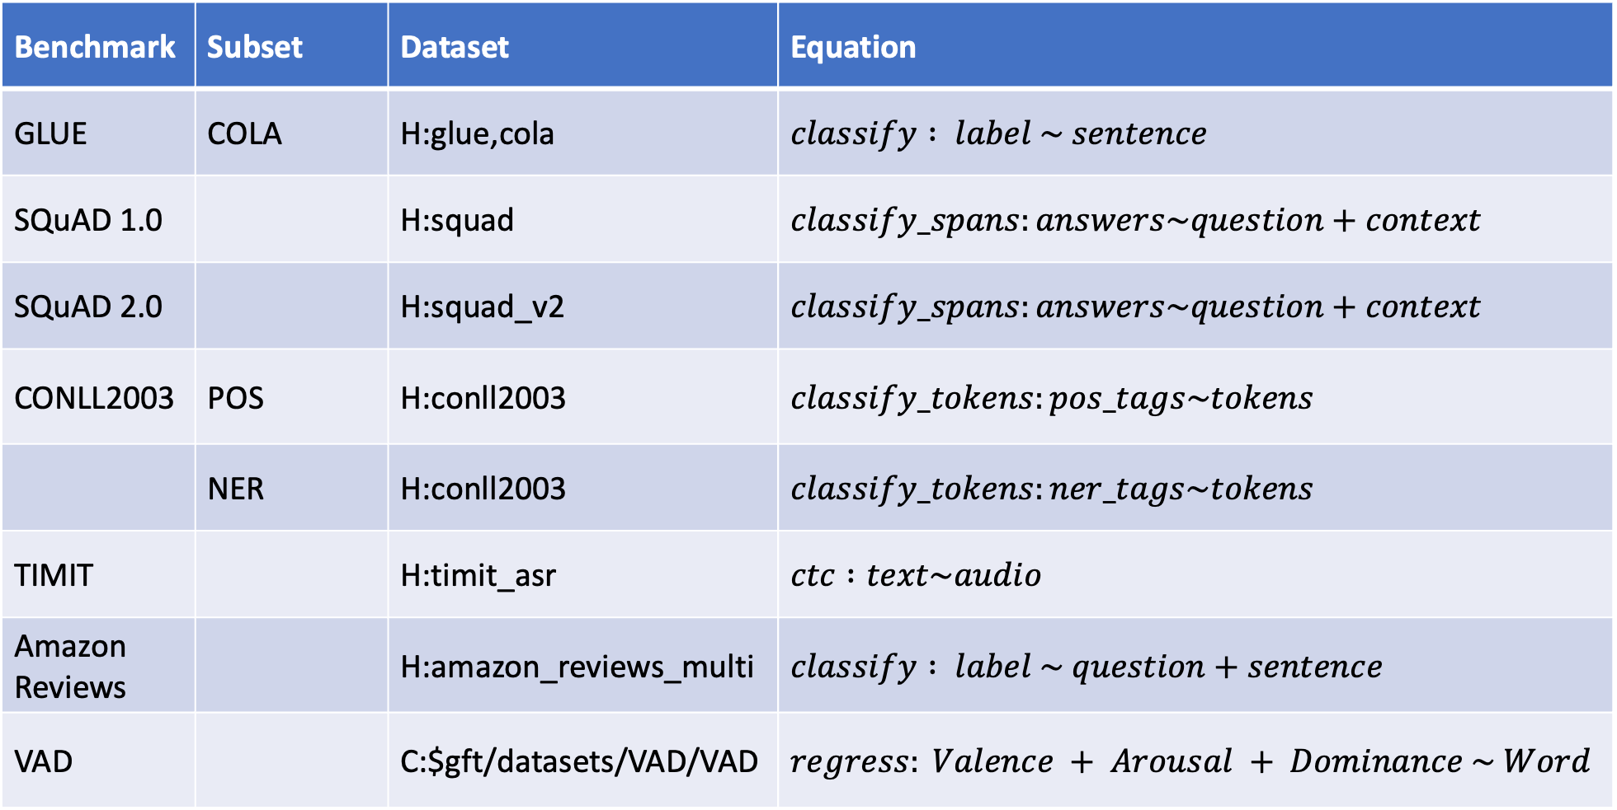

Equation Keywords $≈$ Pipeline Tasks
Benchmark | Subset | Dataset | Equation
GLUE | COLA | H:glue,cola | $$classify : label \sim sentence$$
SQuAD 1.0 |  | H:squad | $$classify_spans:answers\sim question+context$$
SQuAD 2.0 |  | H:squad_v2 | $$classify_spans:answers\sim question+context$$
CONLL2003 | POS | H:conll2003 | $$classify_tokens:pos_tags\sim tokens$$
 | NER | H:conll2003 | $$classify_tokens:ner_tags\sim tokens$$
TIMIT |  | H:timit_asr | $$ctc :text\sim audio$$
Amazon Reviews |  | H:amazon_reviews_multi | $$classify : label \sim question+sentence$$
VAD |  | C:$gft/datasets/VAD/VAD | $$regress: Valence + Arousal + Dominance \sim Word$$

Slide 42



$$regress: Valence + Arousal + Dominance \sim Word$$ https://saifmohammad.com/WebPages/nrc-vad.html
$ℝ^{3}$

Slide 43


$$regress: Valence + Arousal + Dominance \sim Word$$ https://saifmohammad.com/WebPages/nrc-vad.html
$ℝ^{3}$
Train $f$on words, but apply $f$ to texts
(Generalizations: OOVs, MWEs, negation)

Slide 44

gft Cheat Sheet (General Fine-Tuning)
4+1 Functions
4 Arguments
gft_fit: $f_{pre}$ →$f_{post}$(fine-tuning)
4 Arguments, --output_dir, --metric, --splits
(plus most args in most hubs)
gft_predict: $f\left(x\right)→\hat{y}$ (inference)
Input: 4 Arguments ($x$ from data or stdin)
Output: $\hat{y}$ for each $x$
gft_eval: Score model on dataset
Input: 4 Arguments, --split, --metric, …
Output: Score
gft_summary: Find good stuff
Input: 4 Arguments
(may include: __contains__, __infer__)
gft_cat_dataset: Output data to stdout
Input: 4 Arguments (--data, --eqn)
--data
--model
--eqn $task:y\sim x_{1}+x_{2}$
--task
classify (text-classification)
classify_tokens (token-classification)
classify_spans (QA, question-answering)
classify_audio (audio-classification)
classify_images (image-classification)
regress
text-generation
MT (translation)
ASR (ctc, automatic-speech-recognition)
fill-mask

Slide 45





Tasks
$$y∈\left\{0,1,2,…\right\}$$
classify, text-classification
regress
QA, Question Answering, classify spans
token classification
NER (Named Entity Recognition)
POS (Part of Speech Tagging)
translation, MT
ASR, Automatic Speech Recognition, ctc
$y∈ℝ$ or $y∈ℝ^{N}$
$y$ for each start/end of span
$y$ for each token
$y$ for each phoneme

Slide 46

gft Cheat Sheet (General Fine-Tuning)
4+1 Functions
4 Arguments
gft_fit: $f_{pre}$ →$f_{post}$(fine-tuning)
4 Arguments, --output_dir, --metric, --splits
(plus most args in most hubs)
gft_predict: $f\left(x\right)→\hat{y}$ (inference)
Input: 4 Arguments ($x$ from data or stdin)
Output: $\hat{y}$ for each $x$
gft_eval: Score model on dataset
Input: 4 Arguments, --split, --metric, …
Output: Score
gft_summary: Find good stuff
Input: 4 Arguments
(may include: __contains__, __infer__)
gft_cat_dataset: Output data to stdout
Input: 4 Arguments (--data, --eqn)
--data
--model
--eqn $task:y\sim x_{1}+x_{2}$
--task
classify (text-classification)
classify_tokens (token-classification)
classify_spans (QA, question-answering)
classify_audio (audio-classification)
classify_images (image-classification)
regress
text-generation
MT (translation)
ASR (ctc, automatic-speech-recognition)
fill-mask

